Slide 1
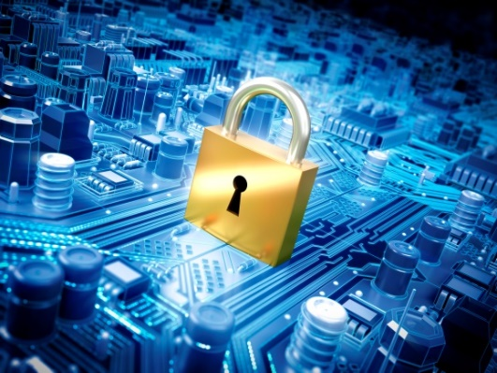
IT-648: IT Risk Management
Week 2
Sonja Streuber

Slide 2
Agenda
# | Topic | Reading | Due 11:59 pm CST on Blackboard
2 | System Administration (1): Linux System Installation, Case Studies | Agrawal 2 Other materials on Blackboard | W: Post F: Responses S: LAB_2

Slide 3
Chapter 2
System Administration (1)

Slide 4
Overview
By the end of this week, you will be able to:
Define the meaning and scope of system administration
Describe the importance of system administration to information security
Enumerate and use general system administration facilities provided by enterprise software

Slide 5
Introduction to System Administration
A set of functions that
provides support services
ensures reliable operations
promotes efficient use of the system
ensures that prescribed service-quality objectives are met
System administration functions
installation, configuration and maintenance
network equipment (switches, routers, DHCP, DNS servers etc)
computer systems (database systems, email systems, ERP systems etc)

Slide 6
System Administrators
Definition
Person responsible for the day-to-day operation of a technology system
First line of defense
System administrators secure critical information systems
May also be system security officers
Person responsible for writing, enforcing and reviewing security operating procedures
Some of the most important IT personnel in an organization
Keep IT humming

Slide 7
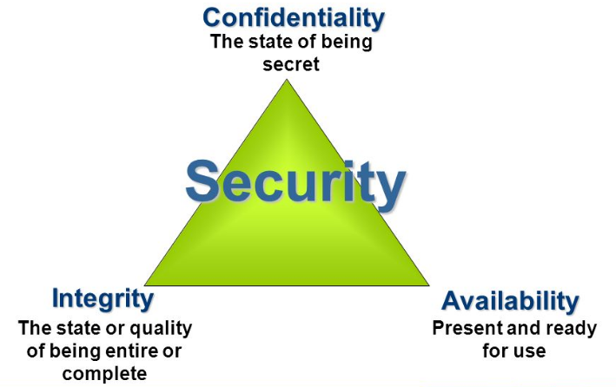
SysAdmin and InfoSec
Use appropriate file permissions: Ensure that unauthorized people cannot not read or copy transcripts
Monitor file and system changes
Anticipate failures: Prevent the hardware failure from affecting end users

Slide 8
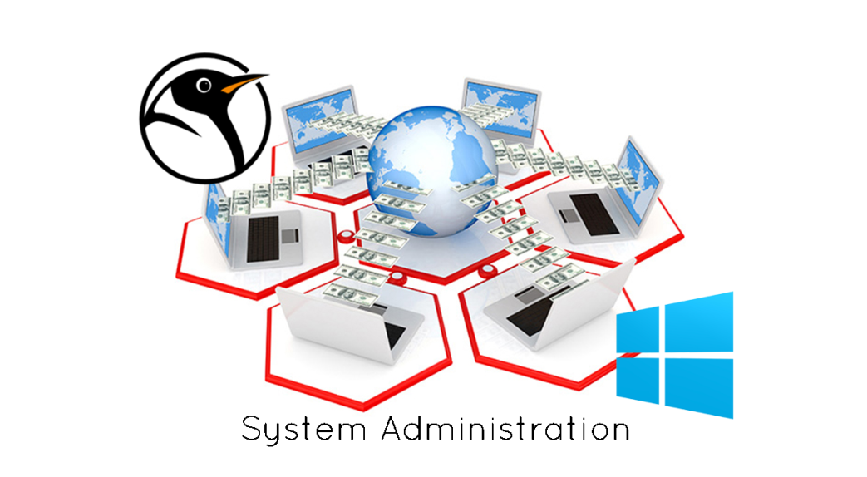
Common system administration tasks
Single Points of Failure
Installation
Updates and Patches
Configuration
Unix/ Linux Utilities
Puppet, Jumpstart
Proactive Testing
Access Control
MS Windows Systems Center
Configuration manager (SW)
Operations center (HW status)
Reactive
Monitoring
User Management
Notes:
Installation
Writing necessary data in the appropriate locations on a computer’s hard drive, for running a software program, e.g. Installing operating system, Installing application programs
System administration challenge: Streamline process across thousands of computers in the organization
Consumers often believe: When in doubt, install
Professional system administrators believe: When in doubt, do not install
Configuration
Selecting one among many possible combinations of features of a system
Has information security implications: Vulnerabilities can arise due to interactions among components, which system administrators must comprehend
Challenge: Many software components desired by end users are not maintained by their creators; resulting information security hazards must be controlled
Access control
Limiting access to information system resources only to authorized users, programs, processes, or other systems and establishing what authorized users can do on a system
Typically refers to: Files or directories a user can read, modify or delete
Can also include: Limiting access to network ports, Application level: Limiting rows and/or columns a user can see in a database or available screens in a business application.
User management
Defining the rights of organizational members to information in the organization (key component of access control)
Creating and removing user accounts
Updating permissions when users change roles
Challenge: Managing large numbers of users--users with similar privileges commonly organized into groups with one permissions profile, e.g., all faculty members in the Computer Science department granted access to mailing list for email discussions.
Monitoring
Listening and and/or recording the activities of a system to maintain performance and security
Required continuously after installation and configuration to ensure desired performance and security
Two kinds:
Reactive monitoring (detecting and analyzing failures after they have occurred, incl. Problem notifications, Analyzing logs after failure, Identify modus-operandi, Identify affected systems)
Proactive testing
Proactive testing
Testing a system for specific issues before they occur
Vulnerability scanners: Access systems and look for potential vulnerabilities, prioritize and resolve identified vulnerabilities, conduct penetration testing (usually carried out by a professional security firm, who actively exploit vulnerabilities found & assess the level of access that is gained)
Recent developments: Chaos Monkey is a service which identifies groups of systems and randomly terminates one of the systems in a group. The service operates at a controlled time (does not run on weekends and holidays) and interval (only operates during business hours). Only runs in business hours with the intent that engineers will be alert and able to respond. See https://github.com/Netflix/SimianArmy/wiki/Chaos-Monkey. Implemented by Netflix.
Updates
Replacing defective software components with components in which the identified defects have been removed
Remove vulnerabilities detected during ongoing use and monitoring of software
Operating system updates: Fix issues with the low-level components of the system software, developed and released by the operating system vendor; all modern operating systems can automatically check for and install required security updates without system administrator intervention
Application updates: Fix problems in individual applications; Typically involve more effort to ensure functioning of plug-ins from other vendors; Many customizations not well documented or tested; Manual updates often necessary to deploy application updates
Typical update procedure: Install update on a development server; Test all applications on the development system; If successful, deploy update to production systems
Single points of failure
A part of a system whose failure will stop the entire system from working is a single point of failur
Related to hardware: Availability implications
Standard solution: Redundancy (Surplus capability, which is maintained to improve the reliability of a system, e.g. spare power supply)
Cold spares: Extra parts used when necessary; Involve down time
Hot spares: Redundant components already in operation that can replace the failed component; No downtime; Used in all mission critical components

Slide 9
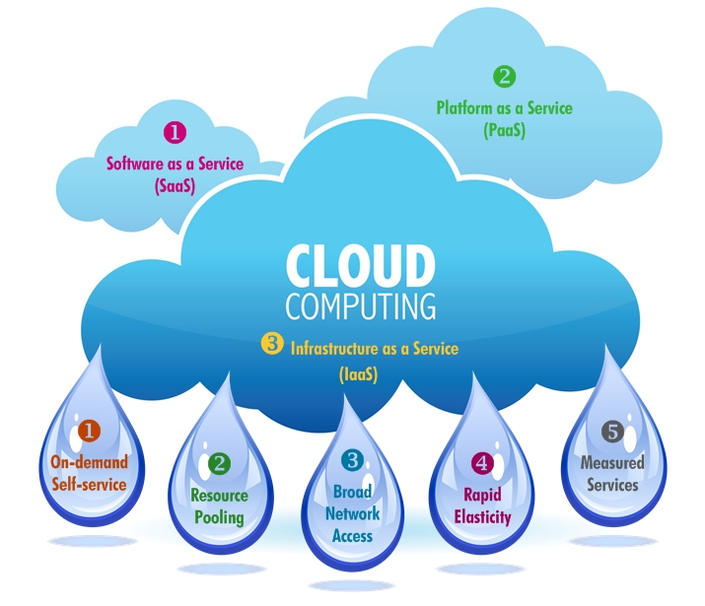
What Difference Can Cloud Computing Make?
NIST Definition
“A model for enabling ubiquitous, convenient, on-demand network access to a shared pool of configurable computing resources than can be rapidly provisioned and released with minimal management effort or service provider interaction.”
Notes:
The first trend is Software as a Service (SaaS). Software as a Service is a software delivery mechanism in which an application and all of the associated resources are provided to organizations by the SaaS vendor, typically through a web browser. The SaaS provider provides all hardware and software and takes on the responsibility for all aspects of system admin- istration. Pricing is typically as a subscription, with a per-user cost paid on a monthly or annual basis. Some SaaS applications are provided free of charge and provide revenue through displaying advertisements. If you have used any of the web-based applications such as Google Docs or used an online storage service such as DropBox, you have used a SaaS application.
The second major trend is Infrastructure as a Service (IaaS). Infrastructure as a Service is a business model in which an organization uses hardware equipment such as processors, storage, and routers from the IaaS provider. IaaS is also considered a form of cloud computing. Unlike SaaS, the IaaS provider provides only the hardware and takes responsibility for just the hardware installation and maintenance. All operating system and application administration must be performed by the organization’s system administrators. Pricing is typically on a subscription basis and is based on usage (e.g., per GB of storage, per million CPU cycles). Amazon and Rackspace are some of the better known IaaS providers.
Security must be handled for data transmission through secure channels, including Virtual Private Networks (VPN) or Encryption, but any local hardware responsibilities are outsourced to datacenters and providers.
Think about Microsoft Office 365.

Slide 10
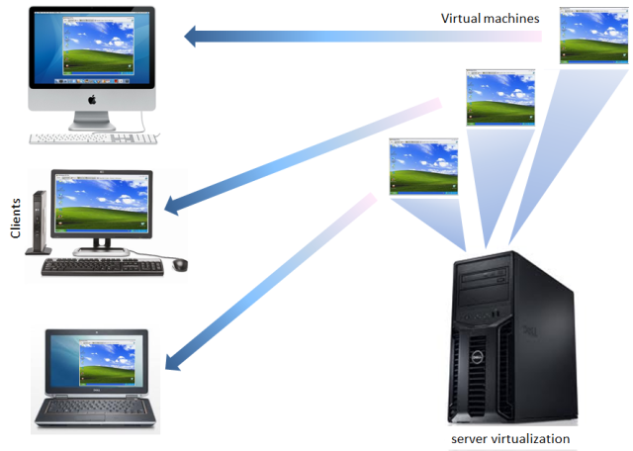
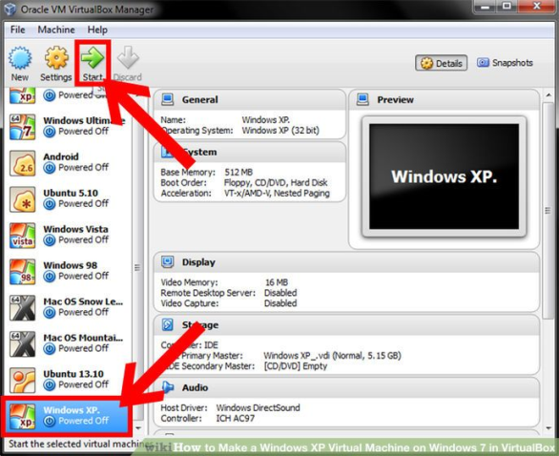
What Difference Can Virtual Machines Make?
A virtual machine (VM) is an operating system (OS) or application environment that is installed on software, which imitates dedicated hardware.
Notes:
The original idea in terms of security was that a virus, when infecting a VM, will spread through the VM only, but not affect the underlying actual OS and therefore not impact the other virtual machines running on it. That is true for a stand-alone machine. But usually, virtual machines are networked, so any malware with a network component (i.e. worms) will propagate to wherever their addressing/routing allows them to. Regular viruses tend to only operate in usermode, so while they couldn't communicate overtly, they could still set up a covert channel. If you are sharing CPU's, a busy process on one VM can effectively communicate state to another VM.

Slide 11
Summary
Role of system administration
Role of system administrators
Common system administration tasks
Enterprise utilities

Slide 12
Chapter Review Questions
What is system administration? Why is system administration important?
Who is a system administrator?
What are some of the important day-to-day activities performed by system administrators?
Define Infrastructure as a Service (IaaS).
What are some of the benefits of using an IaaS provider?
What is a virtual server?
What are some benefits of virtualization?
What is the role of a system administrator in maintaining information security in an organization?
What is software configuration?
How does software configuration impact information security?
Define access control. How can weak access controls impact information security?
Define user management. How does user management impact information security?

Slide 13
Chapter Review Questions
What is monitoring? How does it help information security?
What is reactive monitoring? What are some common reactive monitoring methods?
What is proactive testing? What are some common pro- active testing methods?
What is a system update? What are the challenges in keeping systems updated? Why is it important for information security?
What is a single point of failure? How do system administrators typically deal with single points of failure?
What is the difference between cold spares and hot spares?
What is Active Directory? What role does it play in main- taining information security on Windows computers?
What are group policies? How do group policies assist system administrators in maintaining information security?
What is a domain controller?
Provide a brief description (two to three sentences maximum) of the information security features of the latest version of Microsoft’s System Center or comparable product.
What is Linux? Why is it popular? What are some of the most popular distributions of Linux?
Provide a brief overview (two to three sentences maxi- mum) of the capabilities of Puppet, the IT automation software used by many system administrators.

Slide 14
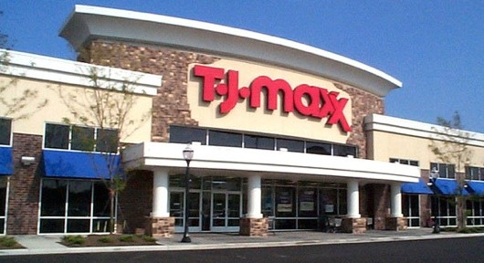
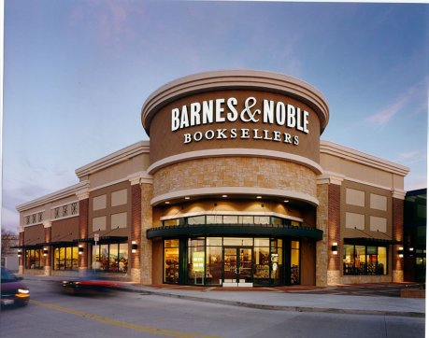
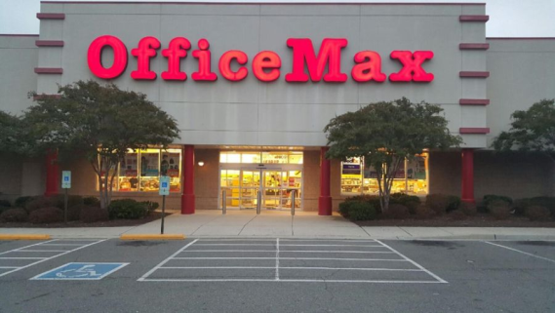
Example case: T J Maxx
Major corporate information security incident in 2007, in which gang of hackers
Used network sniffing equipment to intercept employee logons, passwords, and creditcard transfer traffic (from POS to store servers) over insecured store wireless access points
Gained access to corporate databases because employee accounts were linked to corporate IT
Used SQL injection attacks to place malware on web applications and gain access to corporate & credit card databases
Was discovered in 2008/2009 and indicted for wire fraud, damage to computer systems, conspiracy, criminal forfeiture, and related charges
Damage: ca. $64 million
System administration failure
No encryption at T J Maxx stores
Web application vulnerabilities at other stores

Slide 15
Example Case Questions
Based on the information provided above, list as many example of violation of confidentiality, integrity, and availability identified in the case.
Based on the case, identify the failures in execution of the common system administration tasks at T.J. Maxx at the time of the case
If you were responsible for system administration at T.J. Maxx, what are the things you would have done to pre- vent the occurrence of the incidents reported in the case?

Slide 16
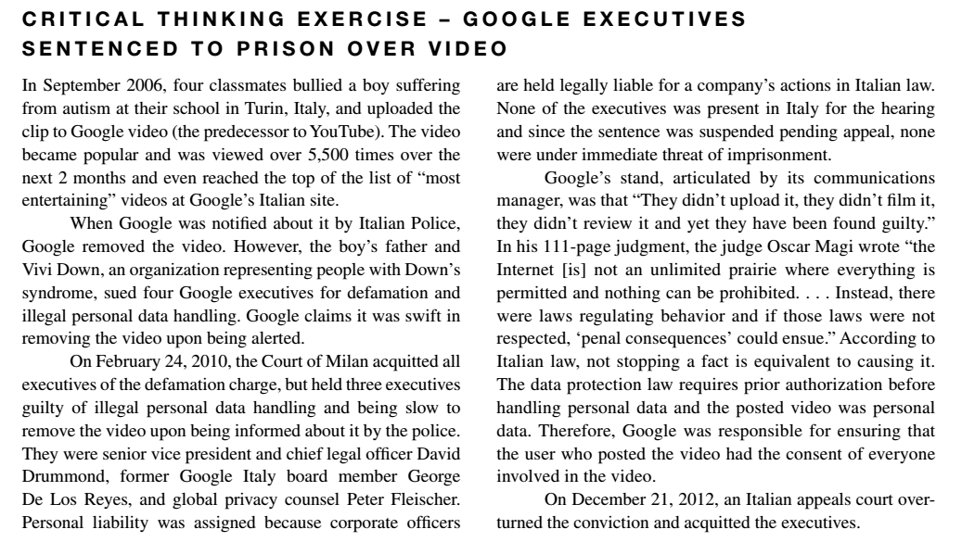
Critical Thinking Exercise

Slide 17
Critical Thinking Exercise Questions
Should system administrators and companies be respon-sible for the content posted by users of a website?
If you are the system administrator of a website and you receive a request from a user to delete a picture uploaded by a friend at a party that includes the user. Would you consider the request reasonable? Would you delete the picture?

Slide 18
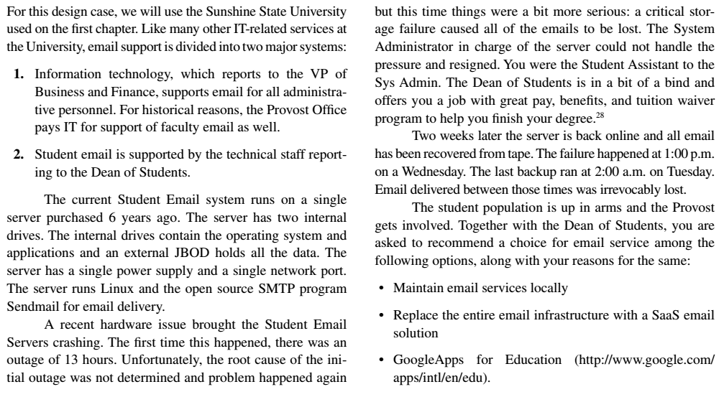
Design Case

Slide 19
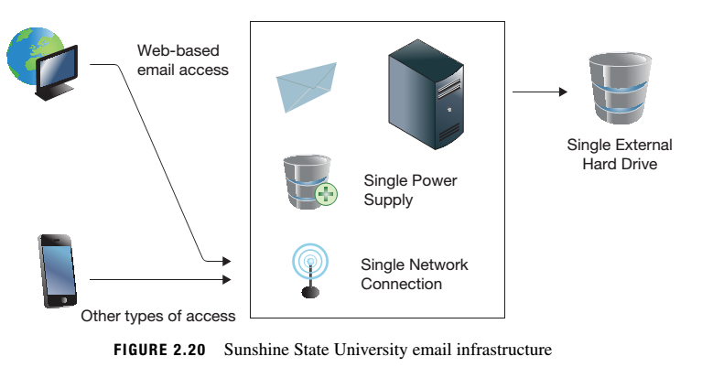
Design Case

Slide 20
Design Case Questions
As you research your options for Sunshine State University, you are advised to start with a common pro- cedure – looking at what your closest peers are doing. Businesses call this benchmarking. In your context, this means what peer universities are doing in terms of email systems.
List three universities or colleges in your area that you would consider the closest peers to Sunshine State. (Keep this list handy. You will find yourself returning to this list often to research what these schools are doing to address the challenges you face in this and later chapters.)
Which of these options has each of the institutions selected for email service? Why did they select this choice? (You may find information regarding this on their websites. You can also call their technical sup- port help line).
If your own institution is not on the list in (a), what is your own institution doing for email service? Why?

Slide 21
Design Case Questions
What problems can you anticipate from Sunshine State’s current system as shown in Figure 2.20? What are the single points of failure? What would have to happen for the local system to be able to safely handle email service if any of these single points of failure were to fail?
What features (if any) do the cloud service models (IaaS and SaaS) offer that could not be currently provided locally?
During your research you find that one of the common queries fielded by technical support is restoration of accidentally deleted email. What facilities (if any) does each alternative provide in the restoration of acciden tally deleted emails?
Another important feature request from the student body is email access from a wide variety of devices, espe- cially non-web clients such as smart phones and tradi- tional email clients such as Thunderbird and Eudora. What support does each of the choices provide for email access from these devices. What advantages or disad- vantages does each system have for such access?

Slide 22
Hands-on Activity
Install VirtualBox
Download and install the OS image
Start the virtual machine
Log in with “alice” and “aisforapple” and look around.

Slide 23
Discussion 1
POST (due WED 11:59 pm CST) : Re-read the design case on p. 49. Imagine this situation happened in your assigned company, and the CEO asks you to provide a recommendation between maintaining email services locally, replacing the entire email infrastructure with a SaaS email solution, or purchasing GoogleApps for Business. Your company’s email infrastructure is the same as that in Figure 2-20. Then answer the following questions:
What problems can you anticipate from your company’s current system as shown in Figure 2.20? What are the single points of failure? What would have to happen for the local system to be able to safely handle email service if any of these single points of failure were to fail?
What features (if any) do the cloud service models (IaaS and SaaS) offer that could not be currently provided locally?
During your research you find that one of the common queries fielded by technical support is restoration of accidentally deleted email. What facilities (if any) does each alternative provide in the restoration of accidentally deleted emails?
RESPONSES (due FRI 11:59 pm CST): Respond to two of your peers' posts. The new system they have chosen obviously needs to handle email access from a wide variety of mobile devices and traditional email clients such as Thunderbird and Microsoft Outlook. What support does their chosen system provide for email access from these devices?

Slide 24
Homework Lab_2
Install the CentOS virtual machine on at least one of the laptops in your group.
Move the directory with the company website files provided in your team’s Blackboard directory to your CentOS desktop.
Start the browser using Applications → Internet → Firefox web browser. Load the index.html file from your team’s company website into the browser
Start the system monitor using Applications → System tools → System monitor.
Start the terminal by selecting Applications → System Tools → Terminal. At the prompt, type in the command “whoami.”
IN A MS WORD DOCUMENT, SUBMIT THE FOLLOWING:
A screenshot of your CentOS desktop (10 points)
A screenshot of the Firefox browser within your CentOS desktop showing your company homepage (10 points)
A screenshot of the System monitor output (20 points)
A screenshot of the terminal window showing the “whoami” command and its output (10 points)

Slide 25
For Next Week
# | Topic | Reading | Due Sunday 11:59 pm CST on Blackboard
3 | System Administration (2): OS Structure, File system | Agrawal 3 Other materials on Blackboard | W: Post F: Responses S: LAB_3

